Slide 1
Comprehensive Digital Marketing
Project Work

Slide 2
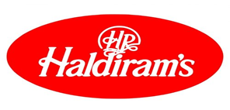

Part 1: Brand study, Competitor Analysis & Buyer’s/Audience’s Persona
Research Brand Identity: Study the brand's mission, values, vision, and unique selling propositions (USPs).
BRAND/TITLE FOR THE PROJECT: HALDIRAM’S
Founded: 1937 Rajasthan, India.
Founder: Ganga Bhishen Agarwal.
Industry type: Food.& beverage.
URLs: https://www.haldiram.com/, https://www.haldirams.com/.
Logo:
Brand colours: Red, white/Yellow, red.
Mission/Values: Haldiram’s mission and vision is to review, recreate and rediscover the trend of healthy eating and innovate and invent fresh new methods to nourish and delight everyone we serve.To achieve continuous and sustainable growth in the business. It makes available

Slide 3
authentic, tasty and quality vegetarian food products made as per global standards at reasonable cost, in India or abroad.
Net worth: $ 3 billion
Headquarters: Nagpur, India.
USP: The Unique Selling Proposition or Unique Selling Point of Haldiram’s to provide wide range of hygienic, tasty and authentic Indian savories and sweet.
Brand slogan/Tagline: “Delicious bhi Dooriyaan bhi”.
Target audience: Middle and upper-middle-class Indian consumers
Rating: 3.5/5
Customer review: Satisfactory

Slide 4
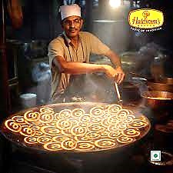
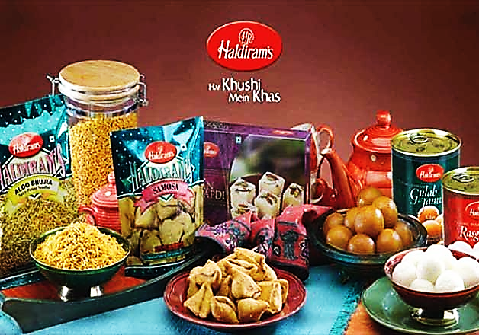
Analyze Brand Messaging:
Brand messaging: Wide variety of flavoured items, nutritional content and good manufacturing practices.
Example: Photos & video links,
https://fb.watch/lV9oyf6GYv/
https://www.instagram.com/reel/CtyyJprADR6/?utm_source=ig_web_copy_link&igshid=MzRlODBiNWFlZA==

Slide 5
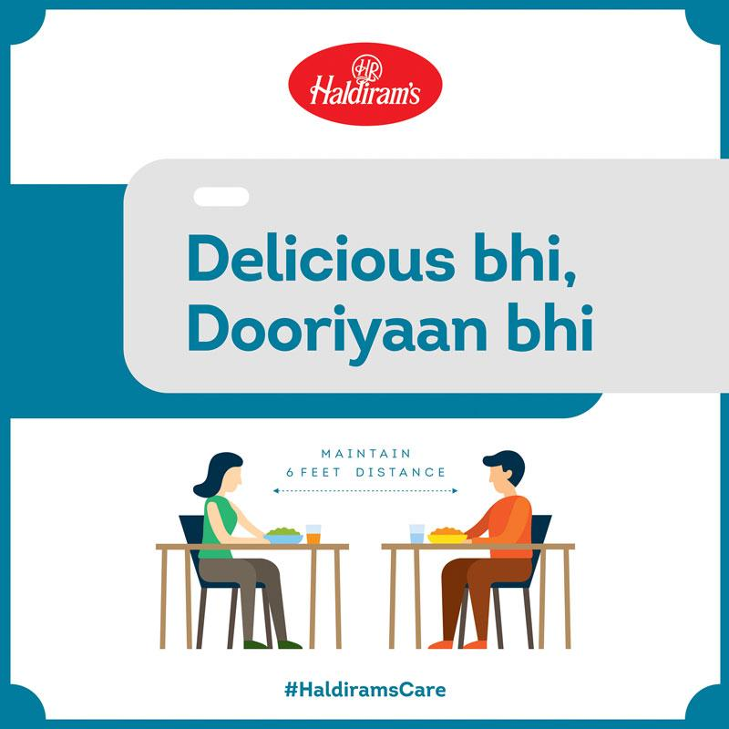
Examine the brand’s tagline:
TAGLINE: “DELICIOUS BHI DOORIYAAN BHI”
Tagline description: The brand promises to take care of the consumers’ hunger as well as the health with secure delivery counters and seating area. Through the tagline “Delicious bhi Dooriyaan bhi” the brand emphasises on the seating arrangement where consumers are requested and restricted to maintain 6 feet distance from individuals to create a temporary practise of social distancing for safe dining experience and to maintain the permanent love of Haldiram's.

Slide 6
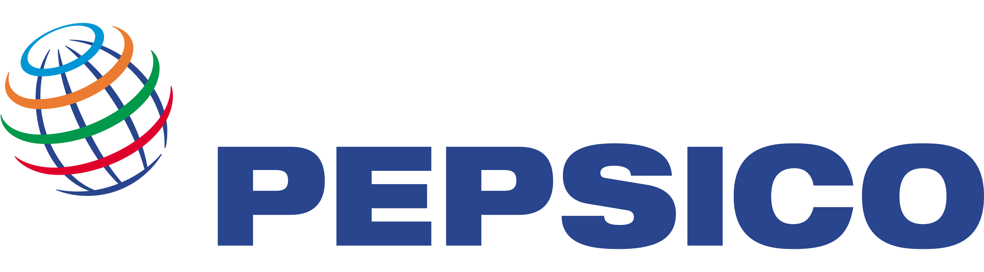

Competitor Analysis: Select three competitors operating in the same industry or niche as the chosen brand, examine their USPs and online communication.
Competitor 1: PepsiCo
URL: https://www.pepsico.com/
Founded year: 1898
Top investors: GVA, LNK Partners & 4 others
USP: One of the popular brands in the foods and beverages sector targeting the youth.
Communication: Measurable content, sponsorships, focuses on young audience.
Overall ranking: 2nd
Competitor 2: Danone
URL: https://www.danone.com/
Founded year: 1919
Top investors: Capital Group, IDEO CoLab & 4 others
USP: World leader in dairy products, bottled water and number 2 in infant foods segment.
Communication: Nutritional content, informative posts, focuses on health & hygiene.
Overall ranking: 3rd

Slide 7
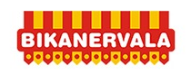
Competitor 3: Bikanervala
URL: https://bikanervala.com/
Founded year: 1950
Top investors: Not known
USP: Good quality, fresh, hygienic and tasty Indian sweets and snacks.
Communication: Attracting large number of audience by funny memes/emojis, relatable content, brand tips and tricks.
Overall ranking: 5th

Slide 8
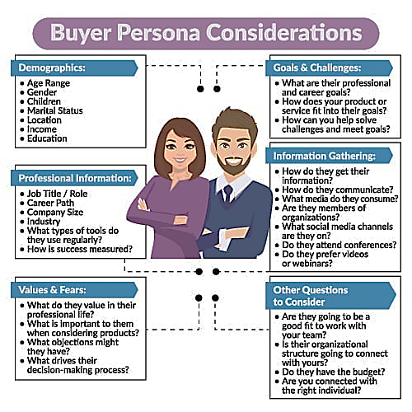
Buyer's/Audience's Persona: Clearly define the target audience for the chosen brand. Consider demographics, psychographics, behaviors, and interests.
Demographics:
7 to 40 years.
Male & female.
May/may not.
Married/unmarried.
Metropolitan cities like Delhi, Mumbai & Kolkata and tier 2 cities like Nagpur, etc..
Rs. 5 LPA to rs. 30 LPA.
Audience from illiteracy level to the higher level of educational qualified can afford this.
Haldiram’s mainly targets middle and upper-middle-class Indian consumers. The target demographic consists of young adults and families who want to enjoy traditional Indian snacks and sweets in an affordable price range. The company also targets foreign customers interested in experiencing authentic Indian food.

Slide 9
Professional information:
Students, government or private employee, employer, retired and households.
Knowledge-based, skill-based, entrepreneur-based, and freelance.
Firm revenue ranging from $1 million to over $40 million.
Primary, secondary, tertiary and quaternary.
Values & fears:
The customer value is defined as how much a product or service is worth to him/her.
Health (eg., calories, special diet needs),taste/preferences (eg., flavor, texture) and time (eg., time to prepare, convenience).
Lack of budget.
Consumers make purchase decisions based on which available options best match their needs, and to minimize the risk of investing poorly.
Psychographics: Haldiram’s is typically associated with quality, authenticity, and convenience. Its customers are mainly looking for convenience and the assurance of quality. Haldiram’s has successfully implemented a comprehensive marketing strategy to expand its reach and increase its market share.
This strategy includes:
Focusing on product quality and innovation.
Optimizing distribution channels and retail locations.
Leveraging advertising and sales promotion.
Utilizing various pricing strategies.

Slide 10
Pricing: Haldiram’s has chosen various strategies to optimize their profits. Cost-plus pricing is used to determine the price based on the product’s cost and a desired profit margin. Penetration pricing is used to gain a competitive edge by offering a lower price than competitors. Finally, skimming pricing is used to increase profits by setting higher prices for innovative products.
Identifying taste explorers: Haldirams meticulously identified distinct archetypes within their target audience, including the Snack Adventurer, the Traditional Food Lover, and the Health Conscious Eater. These personas were carefully crafted, considering demographics, aspirations, challenges, and preferences, enabling Haldirams to establish a personal connection with their customers.
Information gathering:
Consumer reports make consumers aware about certain brands.
Billboards, radio advertisements, TV commercials, newsletters, online bulletins, reviews, and direct communication with the company via its employees.
Interacting with new media, reading books and magazines, watching television and film, and listening to radio.
Social media platforms like Facebook, Instagram, Snapchat, Twitter, Linkedin and Youtube.
Yes, consumers attend conferences for better networking, for expanding knowledge as well as to solve out the problems and for presenting ideas for self and others.
Most of the consumers go through videos unless attending webinars.

Slide 11

Part 2: SEO & Keyword Research
SEO Audit: Do an SEO audit of the brands website
Keyword Research: Define Research Objectives, Brainstorm Seed Keywords, Utilize Keyword Research Tools (SEMrush or Moz Keyword Explorer), Analyze Competitor Keywords, Long-tail Keyword Exploration (specific, longer phrases) that align with the research objectives and have lower competition but higher conversion potential.
On page Optimization: Meta Tag optimization & content optimization
Reflect on the process of conducting keyword research and the SEO recommendations provided.
Document the challenges faced during the research and analysis phase, as well as the key insights gained from the keyword research process.

Slide 12
SEO Audit: Audit Results for Haldiram’s brand:
Usability: Product usability needs improvement. Our page has usability issues across device.usability is important to maximize the product available audience and maximize user bounce rates (which can directly affect our search engine rankings).
Device Rendering : The check visually demonstrates how our page renders on different devices .it is important that our page is optimized for mobile and tablet experiences as today the majority of web traffic comes from these sources.
Core Web Vitals : Page is failed google’s core web vitals assessment. Core web vitals are ui metrics created by google that measure page experience and are becoming increasingly. Important as a ranking factor.
Google’s page speed insights-Mobile: Google is indicating that page is scoring poorly on their mobile page speed insights evaluation.
Note: This evaluation is being performed from US servers and the results may differs slightly from an evaluation carried out from Google’s pagespeed web interfacevas that reporting localizes to the region in which you are running the report.
Google has indicated that the performance of a webpage is becoming more important from a user and subsequently ranking prospective.

Slide 13
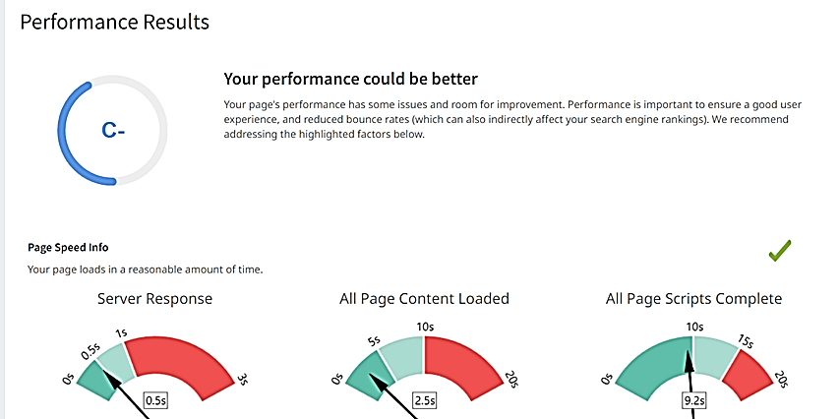

Slide 14
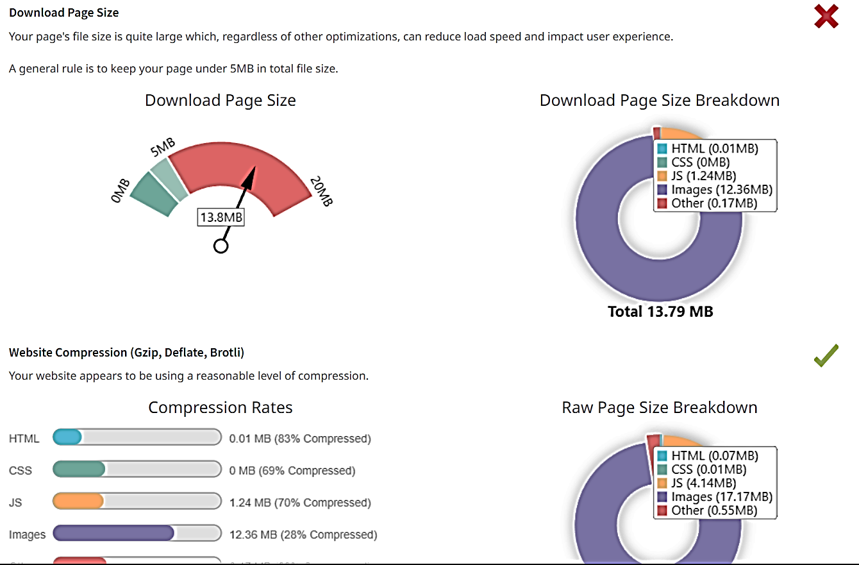

Slide 15
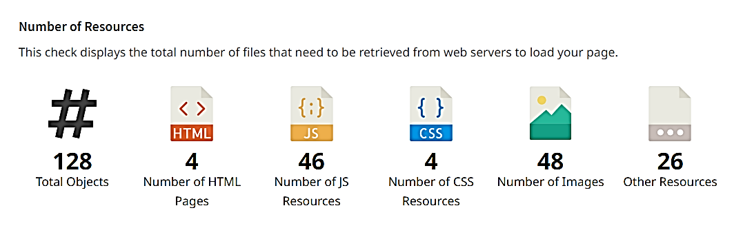
JavaScript Errors: Your page is not reporting any JavaScript errors.
HTTP2 usage: The website is using an outdated http protocol. We recommend enabling HTTP/2+ protocol for our website as it can significantly improve page load speed for users.
Optimize images: All images in Haldiram’s page appear to be optimized.
Minification: All your javascript and CSS files appear to be minified.

Slide 16
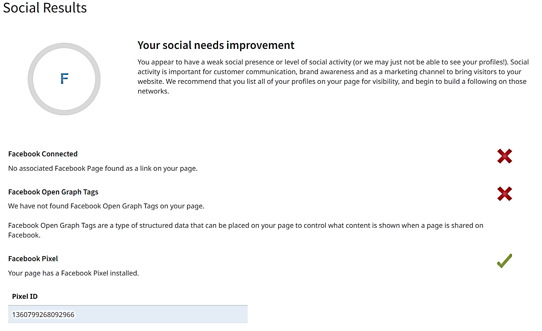

Slide 17

Keyword Research: Keyword research for Haldiram's products would involve identifying relevant and popular search terms that potential customers might use to find or learn about Haldiram's products. This research can help improve the visibility of Haldiram's products in search engines and increase website traffic and sales. Here's a step-by-step guide on conducting keyword research:
Brainstorming: Start by brainstorming a list of words and phrases related to Haldiram's products. Consider the different product categories, specific product names, ingredients, flavors and any unique selling points.
Competitor analysis: Analyze the websites of Haldiram's competitors to identify keywords they are targeting. Tools like SEMrush or Ahrefs can help us gather data on competitor keywords and their search volumes.
Keyword research tools: Utilize keyword research tools to find popular and relevant keywords related to Haldiram's products. Some useful tools include Google Keyword Planner, Uber suggest, KeywordTool.io and AnswerThePublic.
Long-tail keywords: Focus on long-tail keywords, which are more specific phrases that typically have lower search volumes but higher intent. The can help capture more targeted traffic and potentially convert better.

Slide 18
Search volume and difficulty: Pay attention to the search volume and keyword difficulty metrics for each keyword. Search volume indicates how many people search for that term, while keyword difficulty estimates how challenging it will be to rank for that keyword. Balance between high search volume and manageable difficulty.
Local keywords: If Haldiram's has physical store locations, include location-based keywords (e.g., "Haldiram's near me" or "Haldiram's [city name]") to target local customers.
Seasonal keywords: Consider seasonal variations in search trends. Identify keywords relevant to specific holidays or events, as well as seasonal product offerings.
Use customer language: Incorporate keywords that reflect how customers talk about Haldiram's products. Sometimes, people might use different terms or phrases than the official product names.
Avoid keyword stuffing: While including keywords is essential, avoid overloading your content with them (keyword stuffing). Focus on creating valuable and natural content that genuinely helps users.
Organize and prioritize: Group the keywords into relevant categories and prioritize them based on relevance and search volume. This will help in planning content and optimization strategies.
Monitor and refine: Keyword research is an ongoing process. Continuously monitor how the chosen keywords perform and be prepared to refine your strategy based on new trends and data.

Slide 19
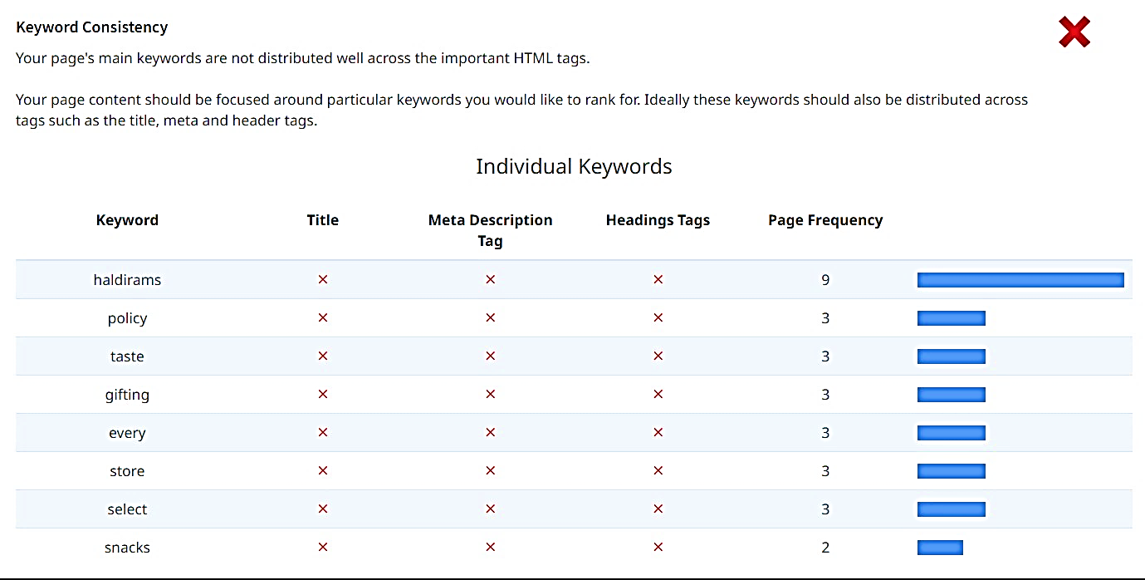
Example: Keywords for Haldiram's products:
"Haldiram's snacks"
"Haldiram's namkeen"
"Haldiram's sweets"
"Haldiram's ready-to-eat meals"
"Haldiram's bhujia"
"Haldiram's aloo bhujia"
"Haldiram's rasgulla"
"Haldiram's gulab jamun"
"Haldiram's samosa"
"Haldiram's paneer tikka"
"Haldiram's bhel puri"
"Haldiram's pani puri"
"Haldiram's instant noodles"
"Haldiram's popcorn"
"Haldiram's gift packs"

Slide 20
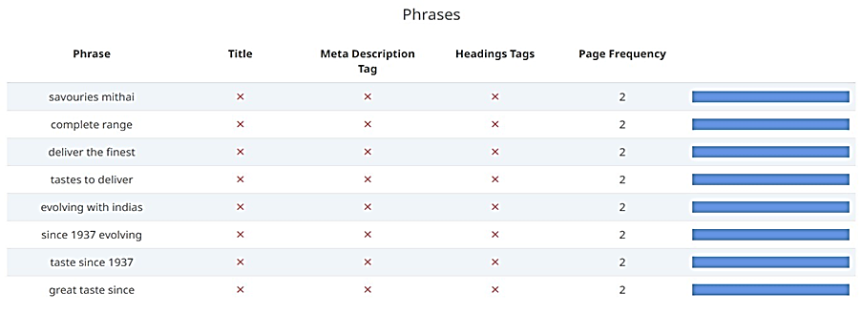
Amount of content:The page has a low volume if the text content which search engine can interpret as ‘thin content’.
Word count: “200 words”. It has been well researched that higher text content volumes are related to better ranking ability in general .

Slide 21
On page Optimization:
Title Tag : it has an optimal length between 10 and 70 characters. E.g., Haldiram’s: Length=10.
Meta Description Tag: The page appears to be missing. A meta description is important for search engines to understand the content of our page, and is often shown as the description text blur in search results.
Example: Searching for namkeen snacks and sweets online order:
SERP Snippet Preview: This illustrates how the page may appear in search results.
Note: This is intended as a guide and search engines are more frequently generating this content dynamically.
https://www.haldirams.com › sweets-73
Buy Haldiram's Packed & Tin Sweets Online at Best Price
Items 1 - 24 of 85 — Order Haldiram's packed sweets online from Haldiram Nagpur's website. Select from wide range of Indian sweets like Rasgulla, Gulab Jamun, ...

Slide 22
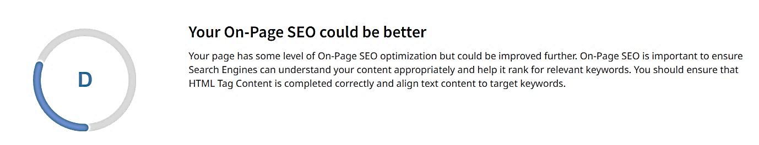
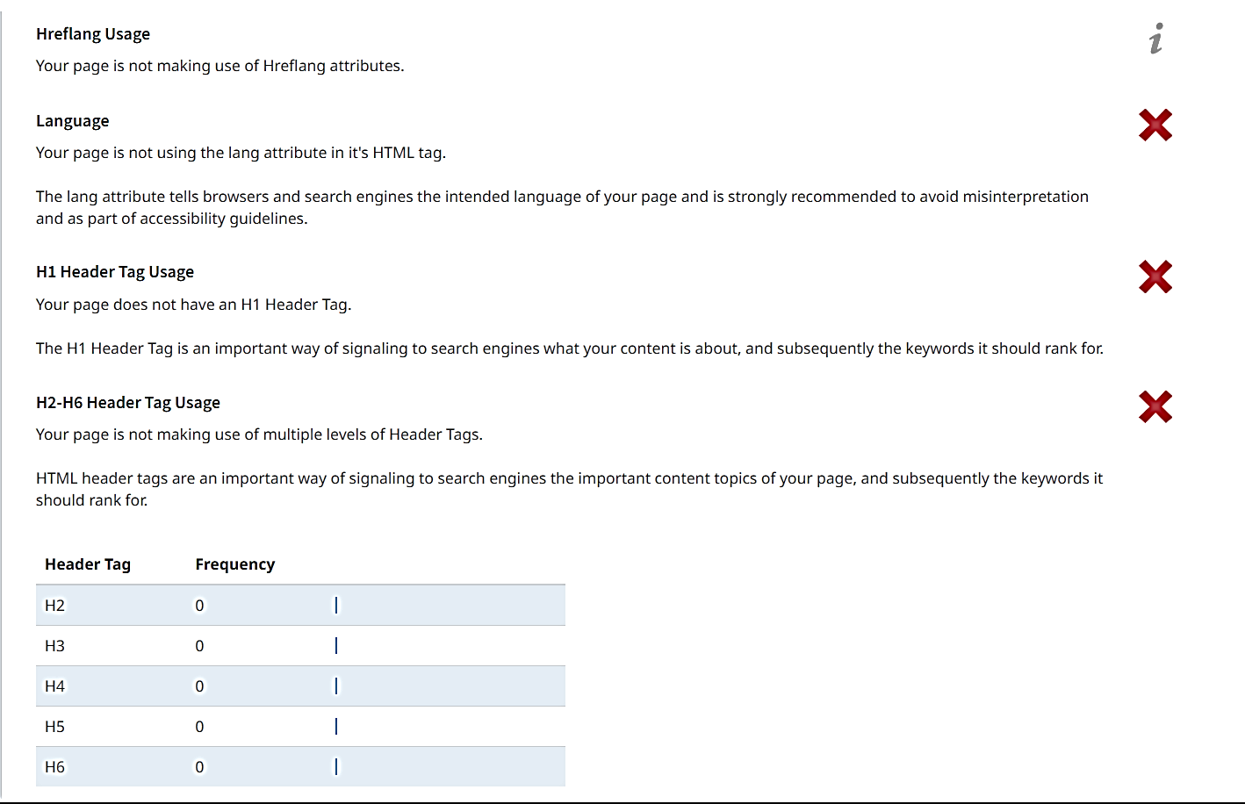

Slide 23
Part 3: Content Ideas and Marketing Strategies
Content Idea Generation & Strategy: Create a content calendar for the remaining month of July by brainstorming content themes, exploring various formats like blog posts, videos, infographics, podcasts, and interactive quizzes, and scheduling publication dates mainly on Facebook & Instagram. And include the strategy, aim and the idea behind these posts and story
Content Calendar Example (Try creating a table for the month of July)

Slide 24
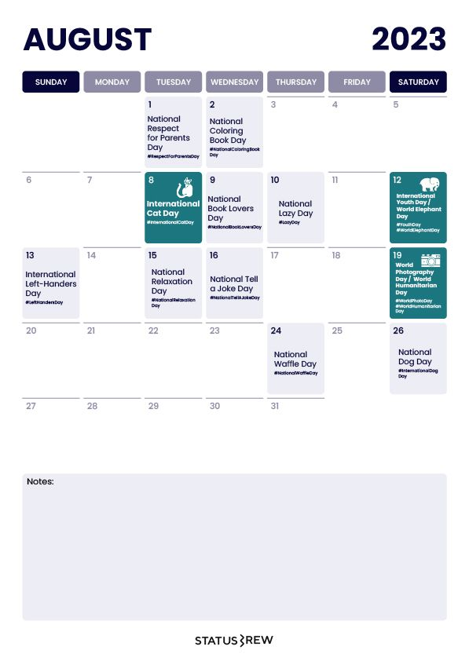
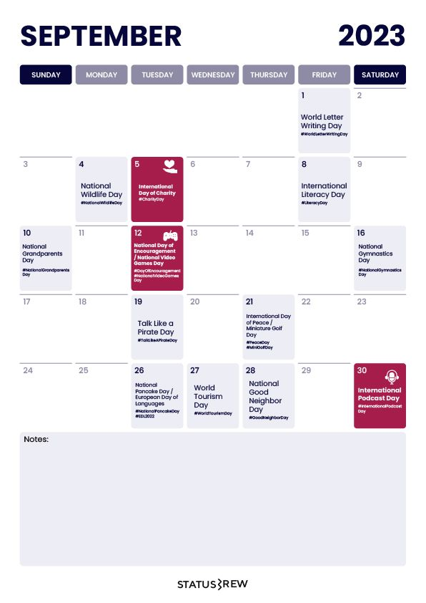
2023
August
30th:
Blog post: Four summer special Indian meals
Infographics: Perks of Taking Haldiram’s Restaurant Franchise
September
1st:
Instagram Story: Poll.
2nd:
Instagram Story: Quizzes
3rd:
Instagram Story: Sneak peeks
7th:
Video: Haldiram's Bhujia Masala, crispy & crunchy, traditional Namkeen, spiced & flavorful, made with All Natural Ingredients

Slide 25
Reflect on the content ideas and marketing strategies process, discussing the challenges encountered and lessons learned.
Whenever we talk about food companies, international brand names like Dominos, McDonald's, or KFC come into our mind. However, we have an Indian brand that has surpassed all these brands by selling Indian products. Yes, the brand is none other than Haldiram's. Haldiram's had started as a small shop in Bikaner. It has now become the largest snacks seller, selling its products in over 80 countries around the world.
Haldiram's is a name that started in the city of Bikaner in Rajasthan with its delicious Bhujia, but its great business strategies and introduction of new products from time to time made it a global brand today. The brand has not only grown and expanded but has also made a huge place for itself in our hearts.
The success story of Haldiram's is not only an achievement for itself but also a great source of inspiration for many.
The Success Story and Business Strategies of Haldiram’s: Haldiram's owes its success to the contributions, dedication, and strategies of mainly three people:
Ganga Bishan Agarwal, who changed the fate of Haldiram’s forever,
Shiv Kishan Agarwal, the second mastermind behind the success, and
Manohar Lal Agarwal, who’s smart strategies made the brand one of a kind.
These three are responsible for implementing great strategies that make the brand a lovable preference for many.
Marketing strategies: Marketing Strategy of Haldiram’s analyzes the brand with the marketing mix

Slide 26
framework which covers the 4Ps. These business strategies, based on Haldiram’s marketing mix, help the brand succeed in the market:
Product Strategy: The various food products offered by Haldiram’s include namkeens, papads, sweets, drinks, banana chips, halke fluke, takatak, frozen curries, frozen paratha, frozen rice, frozen thali, frozen snacks and canned sweets.
Price/Pricing Strategy: Haldiram’s follows a competitive pricing strategy in order to compete with huge unorganised snacks and sweet sector in India.
Place & Distribution Strategy: Haldiram’s Manufacturing in Delhi, Haldirams Bhujiawala in Kolkata and Haldirams Foods in Nagpur.
Promotion & Advertising Strategy: Haldiram’s has now come up with small 30 seconds YouTube ads to target the urban and international customers. It also does city-level promotions using colourful hoardings and posters.
Challenges faced and lessons to be learn: We Indians love to snack, so the market is booming. Whether it is a famous Indian brand like Haldiram’s and Bikanervala, MNC like Pepsi or a small, local mithaiwala, they all seem to have a market for their products and enjoy tasty profits.
However, Haldiram’s being one of the successful manufacturers in traditional namkeen and sweets distribution has faced few basic challenges during its commencement and make us make us learn the following lessons
Challenges:
Haldiram’s informal split between three units.
They began as distinct entities.

Slide 27
After the popularization of its “Bhujia”, Aggarwal came to use the name “Haldiram’s bhujia wala” in 1941.
Decade following India’s independence.
Ganga Aggarwal’s son and grandson aimed to expand their business.
Calcutta manufacturing units, 1970.
Mumbai manufacturing units, 1990.
Restaurant in New Delhi, 1995.
Learning outcomes: :
Capturing consumer’s imagination.
Never being settled.
Thinking globally.
The sky”s the limit.
Keeping it simple.
To watch-out your Economics.
Building a brand.

Slide 28
Part 4: Content Creation and Curation (Post creations, Designs/Video Editing, Ad Campaigns over Social Media and Email Ideation and Creation)
Post Creation:
Select Content Categories: Identify three different content formats relevant to the chosen topic or industry. Research and Brainstorm: Research trending topics, industry news, or audience interests within each category. Brainstorm ideas for social media posts that align with each category. Do note that 1 content format has to be video and additionally 3 stories/status are to be created.
Format 1: Blog post
Format 2: Video
Format 3: Infographics

Slide 29
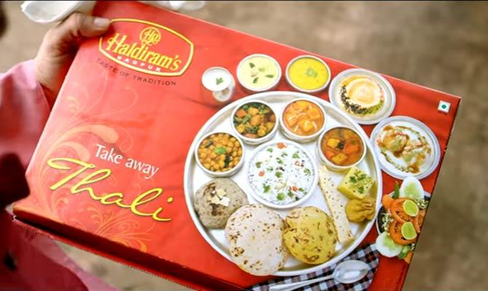
Blog post:
Aim: Boost SEO and provide information about a certain new products.
Date: August 30th, 2023
Idea: This summer Haldiram”s had light up on a few Indian meals to reach out the tastes of its audience and this blog Is a direct link towards it.
Topic: Four summer special Indian meals.
Summer is here, and with the scorching heat, who wants to spend hours slaving away in the kitchen? But worry not, because we’ve got you covered with these five summer special Indian meal ideas that can be prepared in just minutes! Whether you’re craving the creamy goodness of Palak Paneer or the aromatic flavors of Veg Biryani, we have something to tickle your taste buds and keep you full this season. So, let’s dive right in and discover these quick and delicious meal options that will make your summer days a breeze!

Slide 30
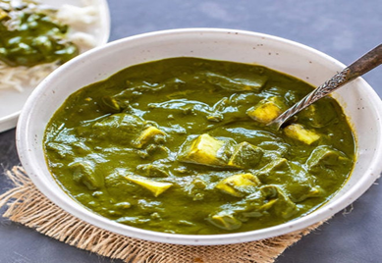
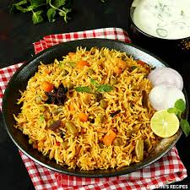
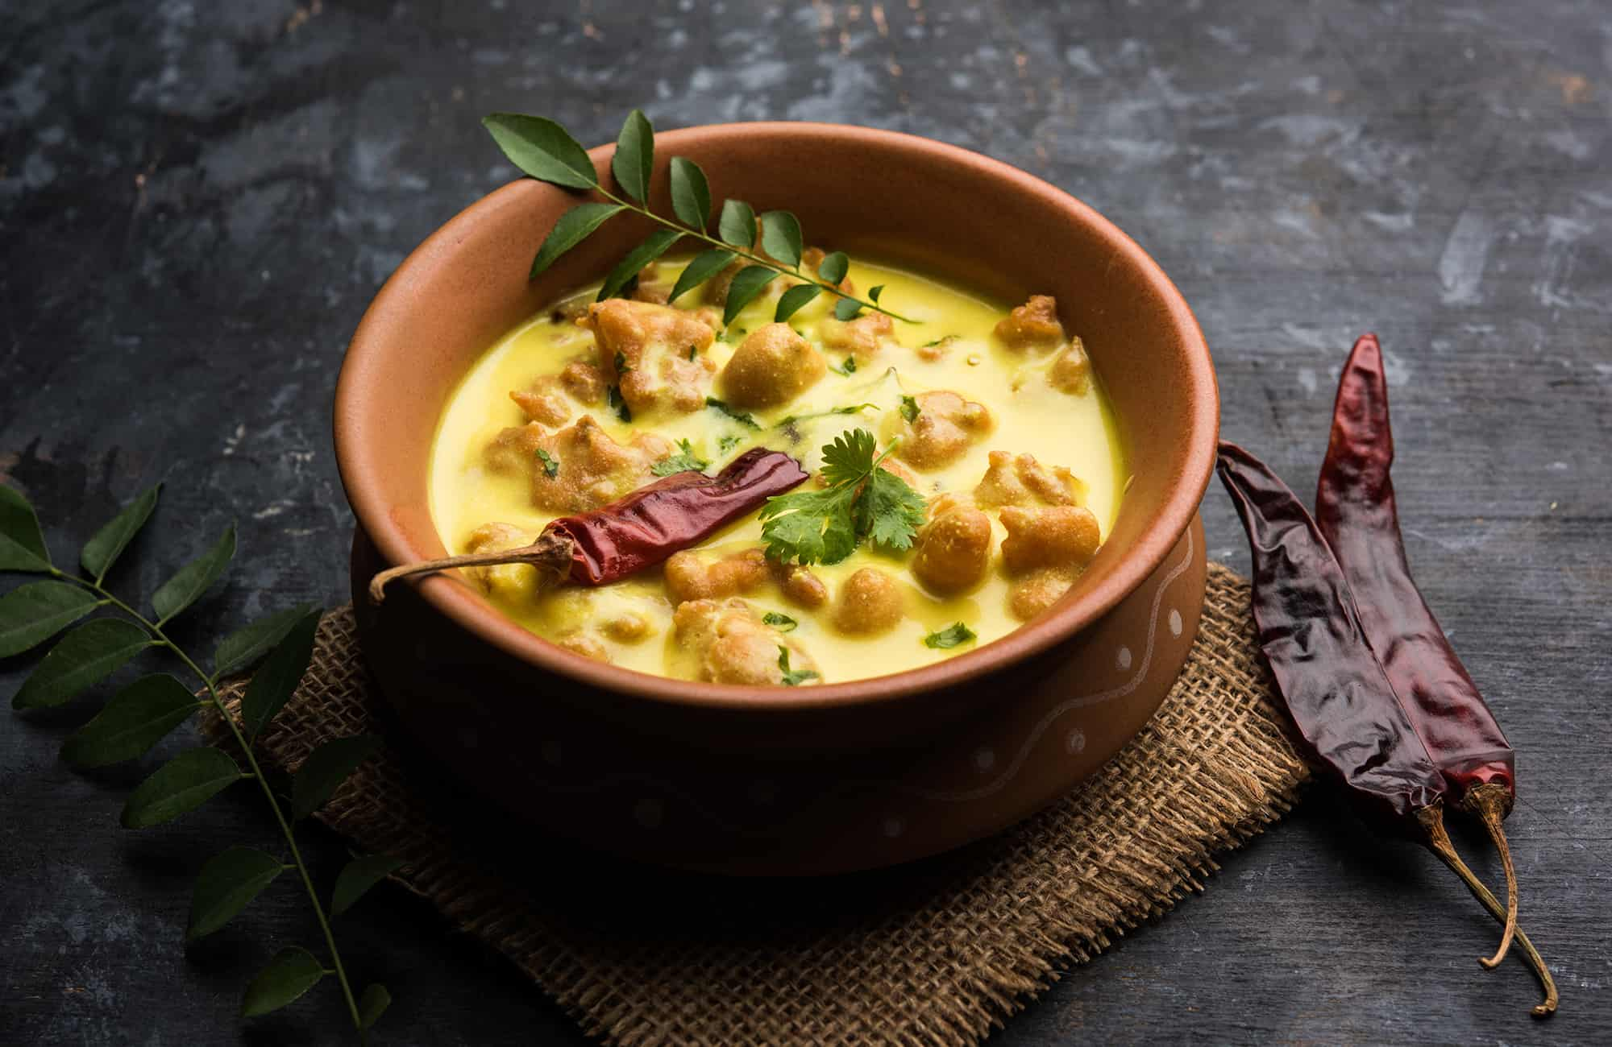
Palak Paneer: Let’s start with a classic favorite that never fails to impress – Palak Paneer! This delightful dish combines the goodness of spinach with soft paneer cheese, creating a creamy and nutritious delight. To whip up this summer sensation in minutes, all you need is a packet of our ready-to-eat Palak Paneer. Heat it up in a pan, garnish with some fresh coriander, and voila! You have a mouthwatering dish ready to savor. Serve it with hot rotis or steamed rice for a complete and satisfying meal.
Veg Biryani: Who says you need hours to prepare a flavorful biryani? Our quick and easy Veg Biryani is here to save the day! Packed with aromatic spices, colorful veggies, and fragrant basmati rice, this one-pot wonder will transport you straight to the streets of India. Simply heat up our ready-to-eat Veg Biryani, fluff the rice with a fork, and you’re ready to relish the flavors of this delectable dish. Serve it with some cooling raita or a refreshing cucumber salad for the perfect summer meal.
Kadhai Pakora: Crunchy, spicy, and oh-so-delicious, Kadhai Pakora is a popular Indian street food that screams summer indulgence. With our ready-to-eat Kadhai Pakora mix, you can enjoy this mouthwatering snack in minutes. Just follow the instructions on the packet, fry up the pakoras until golden brown, and serve them hot with a tangy tamarind chutney. These crispy fritters are perfect for snacking or as an appetizer for your summer get-togethers.

Slide 31
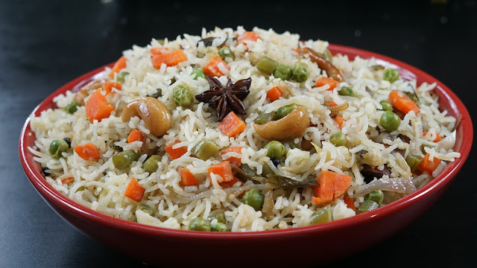
Veg Pulao: When you’re short on time but still crave a flavorful meal, our Veg Pulao is the answer. Bursting with colorful veggies and fragrant spices, this quick and easy dish will satisfy your taste buds and keep you feeling light during the summer heat. With our ready-to-eat Veg Pulao, all you need to do is heat it up in a pan, fluff the rice gently, and get ready to indulge in the delightful flavors of this aromatic rice dish. Pair it with some refreshing cucumber raita or a zesty lemon pickle for a complete meal that’s ready in minutes.
Don’t let the summer heat dampen your enthusiasm for delicious Indian cuisine. With these five quick and easy meal ideas, you can savor the flavors of Palak Paneer, Veg Biryani, Kadhai Pakora, Veg Pulao, and Mango Lassi in just minutes! So, ditch the hot stove and enjoy the season with these ready-to-eat delights. Remember, great food doesn’t always require hours of cooking; sometimes, it’s the quick and tasty options that bring the most joy. Happy summer munching!

Slide 32
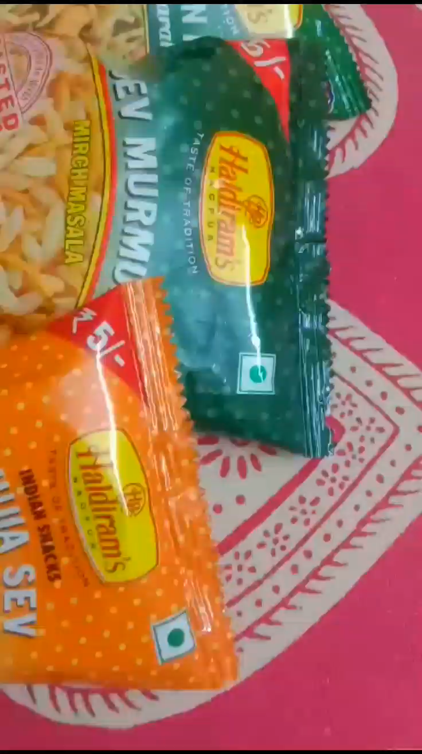
Video:
Aim: Boost SEO and provide information about a certain new products.
Date: September 7th, 2023
Idea: Food videos for experiments on special recipe ideas.
Topic: Haldiram's Bhujia Masala, crispy & crunchy, traditional Namkeen, spiced & flavorful, made with All Natural Ingredients.
URL:
https://www.instagram.com/reel/Cw5i2QpvC4Q/?utm_source=ig_web_copy_link&igshid=MzRlODBiNWFlZA==

Slide 33
Infographics:
Aim: For exponential growth
Date: August 30th, 2023
Idea: Starting Franchise Restaurants is a way to expand your business, wherein you (the franchisor) give a license to independent owners (Franchisee) to use your Trademark, business model, and processes to sell or provide services under your Brand Name.
Topic: Perks of Taking Haldiram’s Restaurant Franchise.
Top snack brand: Haldiram’s has established itself as a top snacking brand in India. Everyone knows the name of Haldiram’s and has an emotional inclination towards this name.
Great Margin & ROI: Haldiiram’s food products offer great margin to the franchise owner that comes with an opportunity to enjoy great profits and return on investment.
Top Quality Support: Haldiram’s provides you top quality training and support to establish your restauraant frenchise. With their excellent guidance, you will never face any problem.
Great Range of Products: Haldiram’s has over 400+ awesome products in their entire product range which includes sweets, namkeens, beverages, etc.
URL: https://www.facebook.com/photo?fbid=122095174586031460&set=pcb.122095175720031460, https://www.facebook.com/photo?fbid=122095175552031460&set=pcb.122095175720031460; https://www.instagram.com/p/CwrwLijvnQd/?img_index=1

Slide 34
Instagram Story
Utilize the Stories feature on Instagram for three consecutive days. Share behind-the-scenes glimpses, polls, quizzes, or sneak peeks etc to encourage audience participation. Once uploaded use the story highlight feature on Instagram and save the 3 story with an appropriate name for each. Note: Once done monitor the performance of the posts and Stories using the insight tool and analyze the engagement metrics (likes, comments, shares, impressions, etc.). Based on the analysis, mention the strategies and areas for improvement.

Slide 35
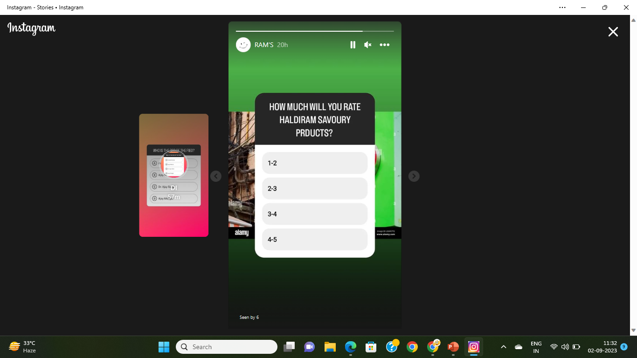
Poll:
URL: https://www.instagram.com/stories/highlights/17999212786912547/
Date: September 1st, 2023

Slide 36
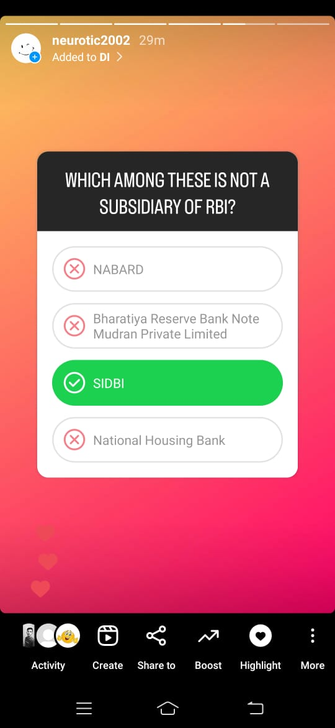
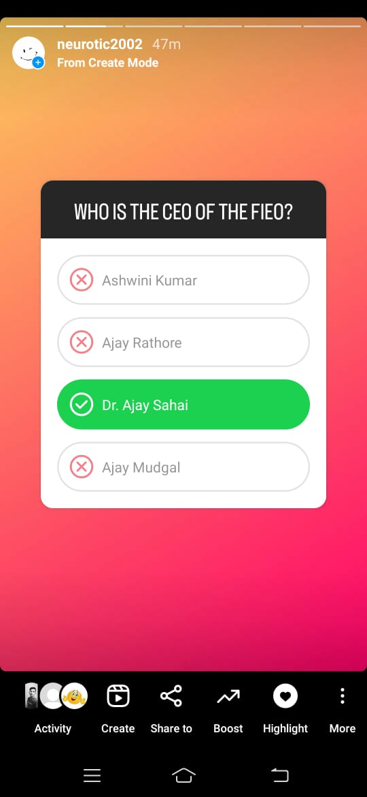
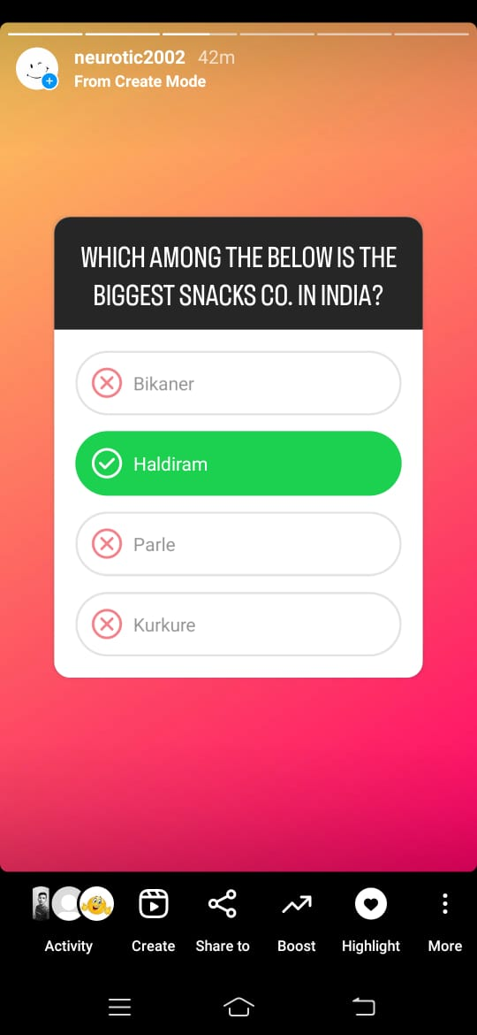
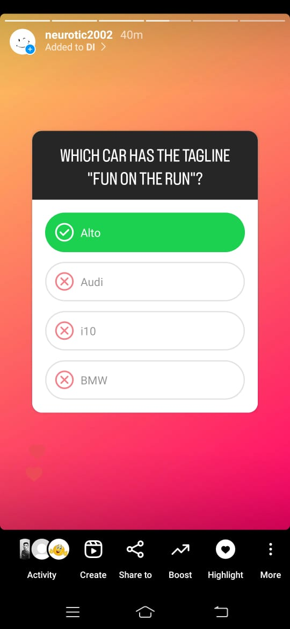
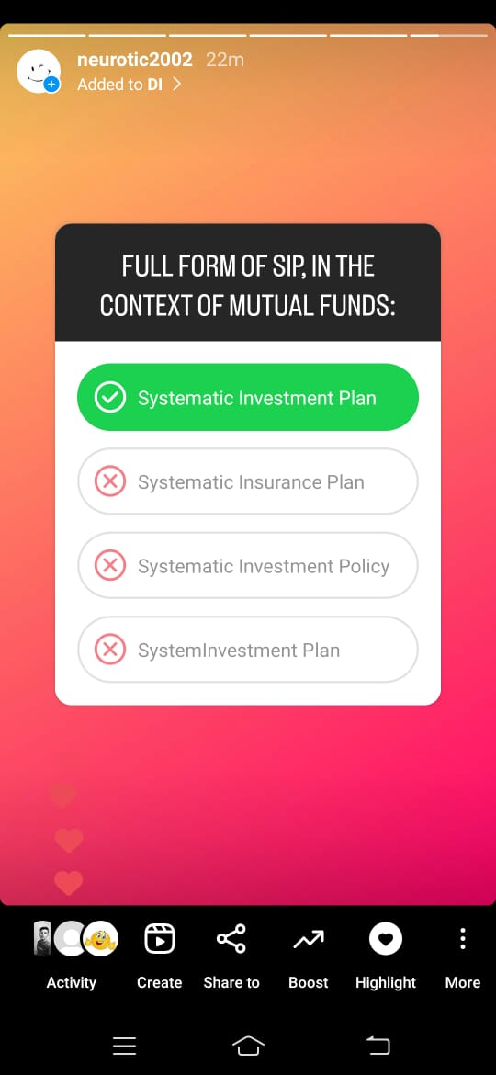
Quizzes:
URL: https://www.instagram.com/stories/highlights/18281042647177824/
Date: September 2nd, 2023

Slide 37
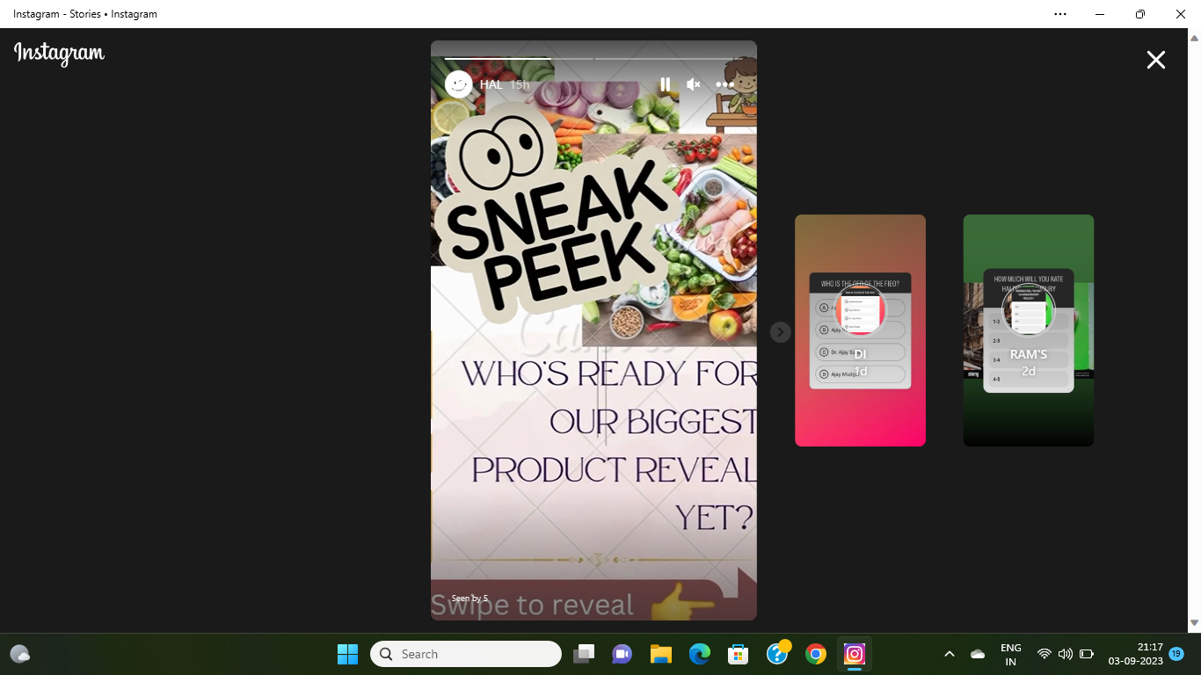
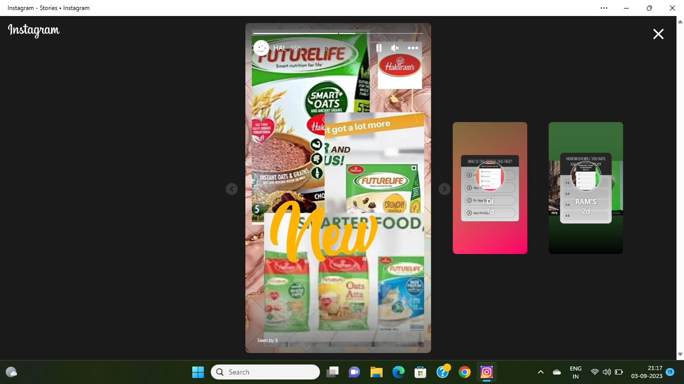
Sneak peeks:
URL: https://www.instagram.com/stories/highlights/18283487620182153/
Date: September 3rd, 2023

Slide 38
Designs/Video Editing
Design Tools Familiarization (use Canva for creating visually appealing graphics)
Video Creation: Utilize VN or any video editor of your choice to create videos related to the chosen topic.
URL: https://www.instagram.com/reel/Cw5i2QpvC4Q/?utm_source=ig_web_copy_link&igshid=MzRlODBiNWFlZA==

Slide 39
Social Media Ad Campaigns
Ad Campaigns over Social Media:
Come up with 3 ad campaigns each covering one of the mentioned goals: brand awareness, driving website traffic, or generating leads

Slide 40
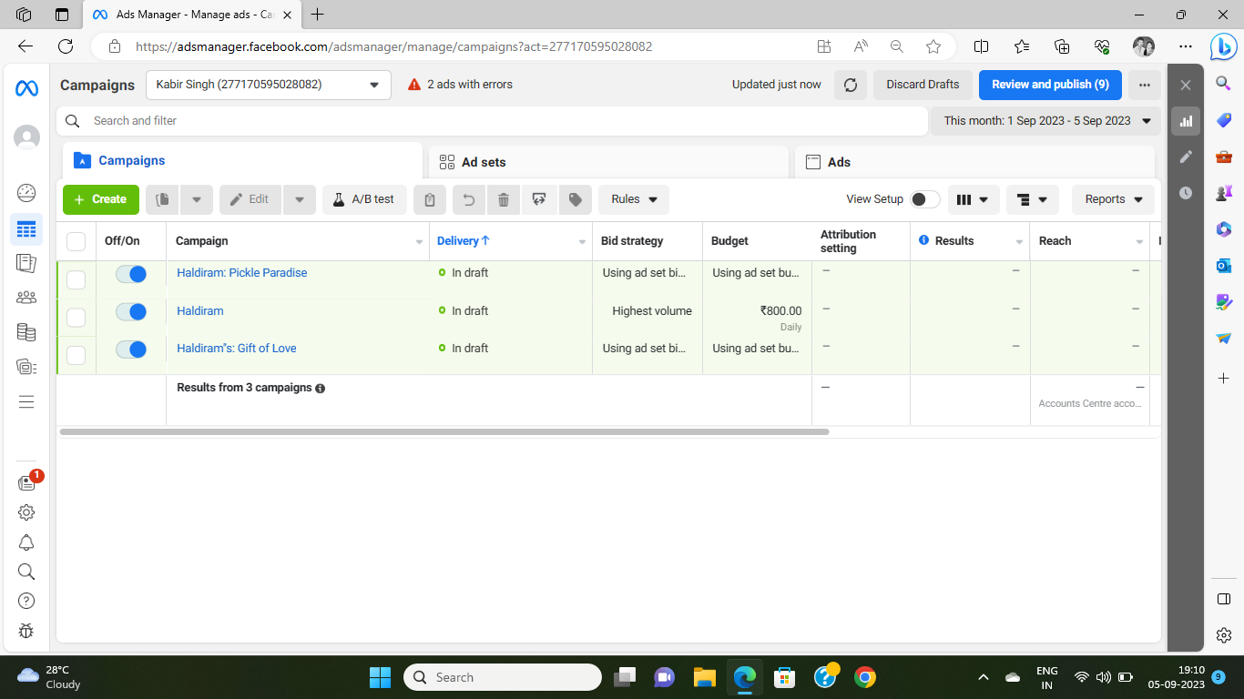
For every campaign clearly define:
Advertising Goals: increasing brand awareness, driving website traffic, or generating leads.
Audience Targeting: Define the target audience for the ad campaigns based on demographics, interests, and behavior.
Ad Creation: Create visually appealing ad creatives, compelling ad copy and relevant call-to-action.

Slide 41
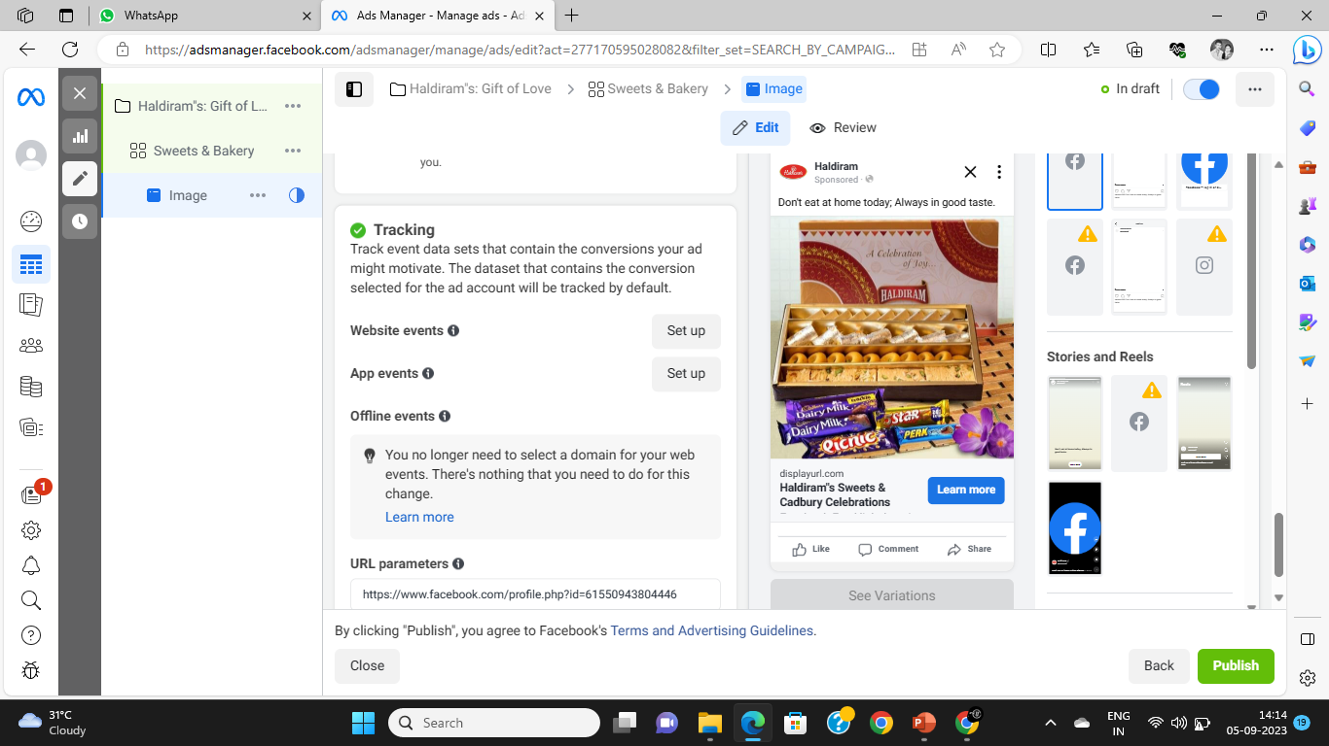
Brand Awareness Campaign:

Slide 42
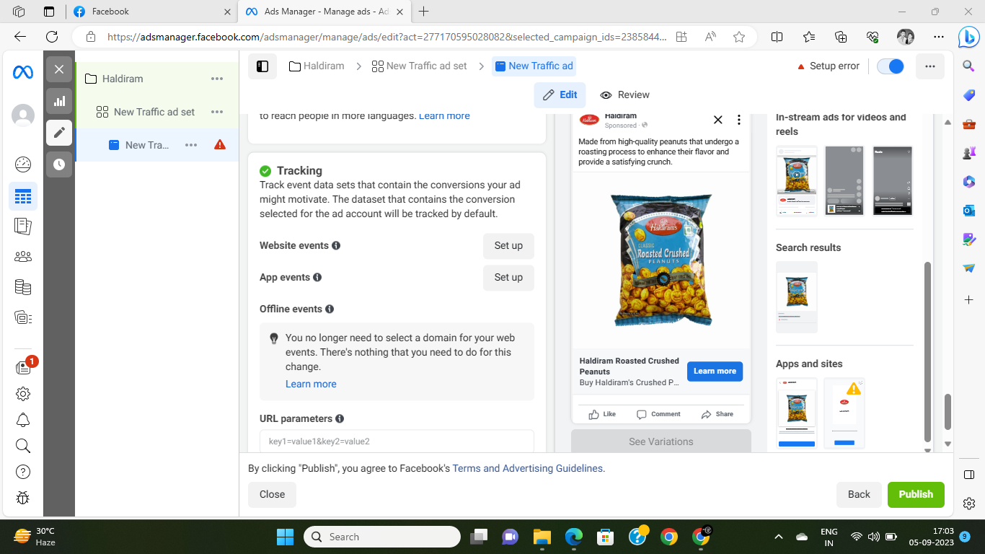
Driving Website Traffic Campaign:

Slide 43
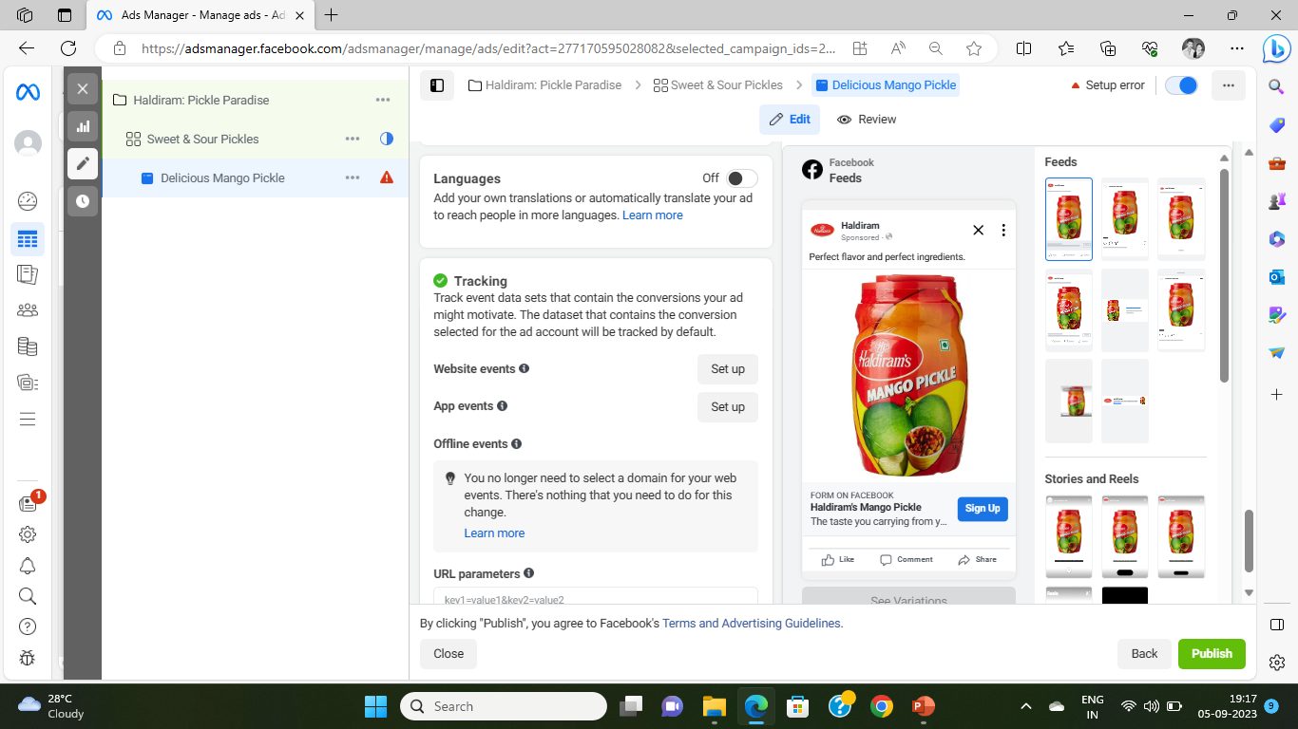
Generating Leads Campaign:

Slide 44
Email Ad Campaigns
Ad Campaigns for email marketing:
Come up with 2 email ad campaigns with the mentioned goals: brand awareness & generating leads

Slide 45
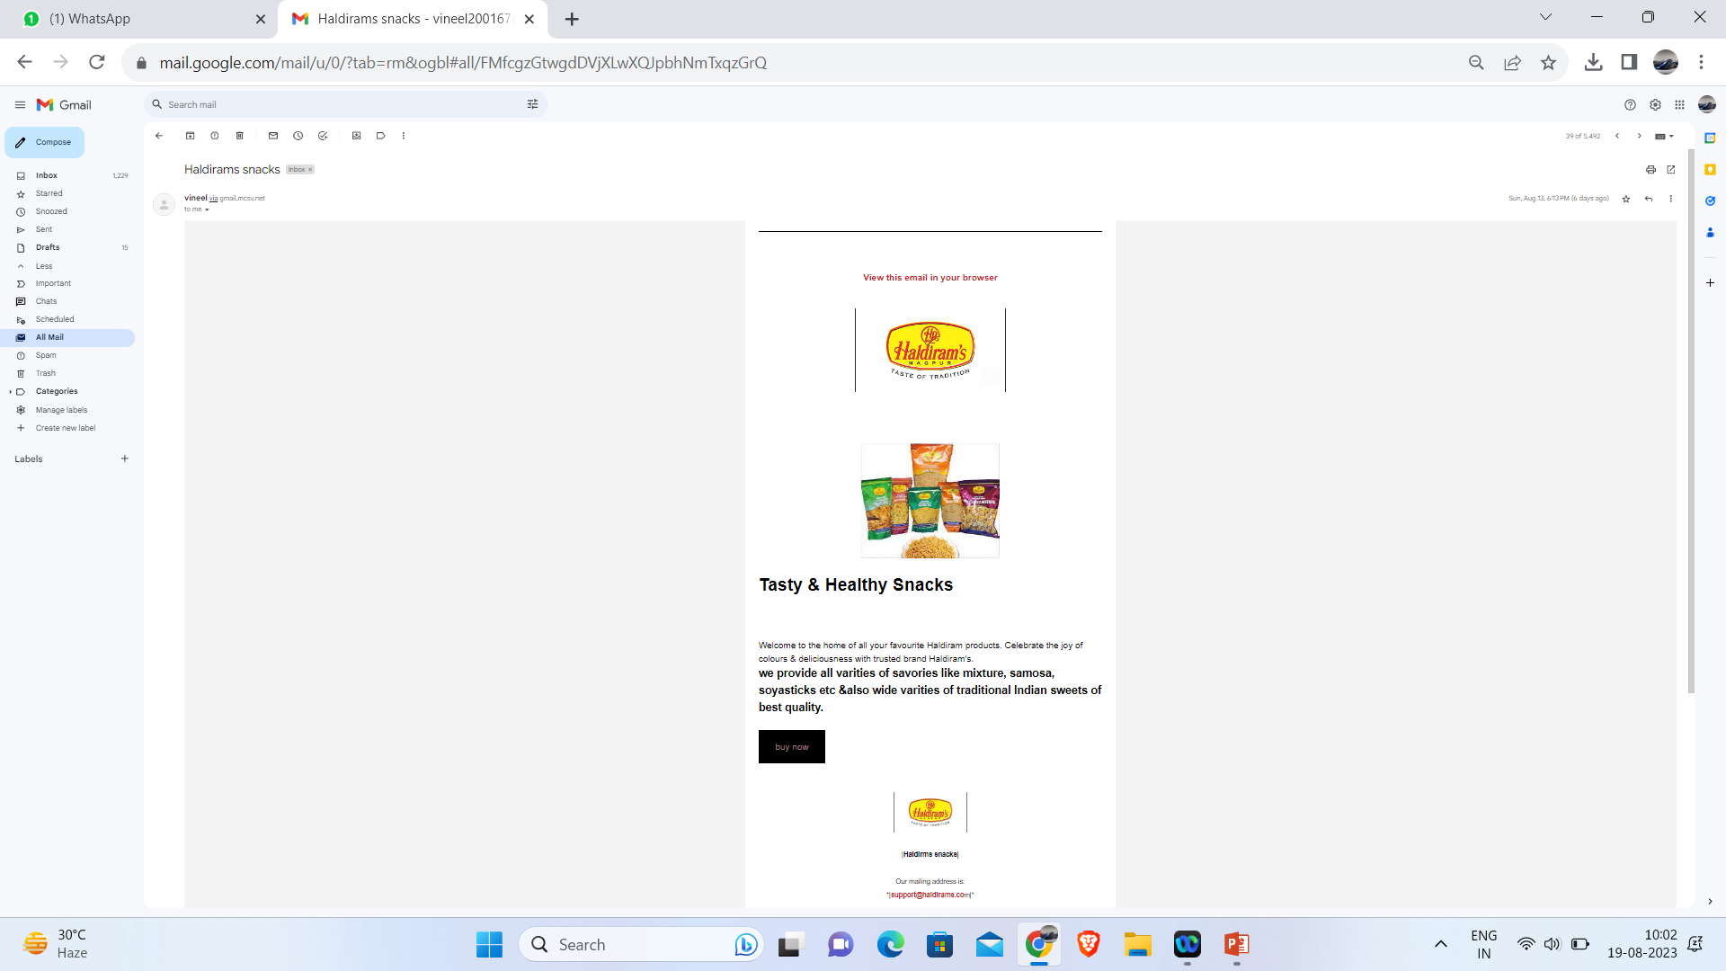
Email Ad Campaign 1 - Brand Awareness
(insert emailer image)

Slide 46
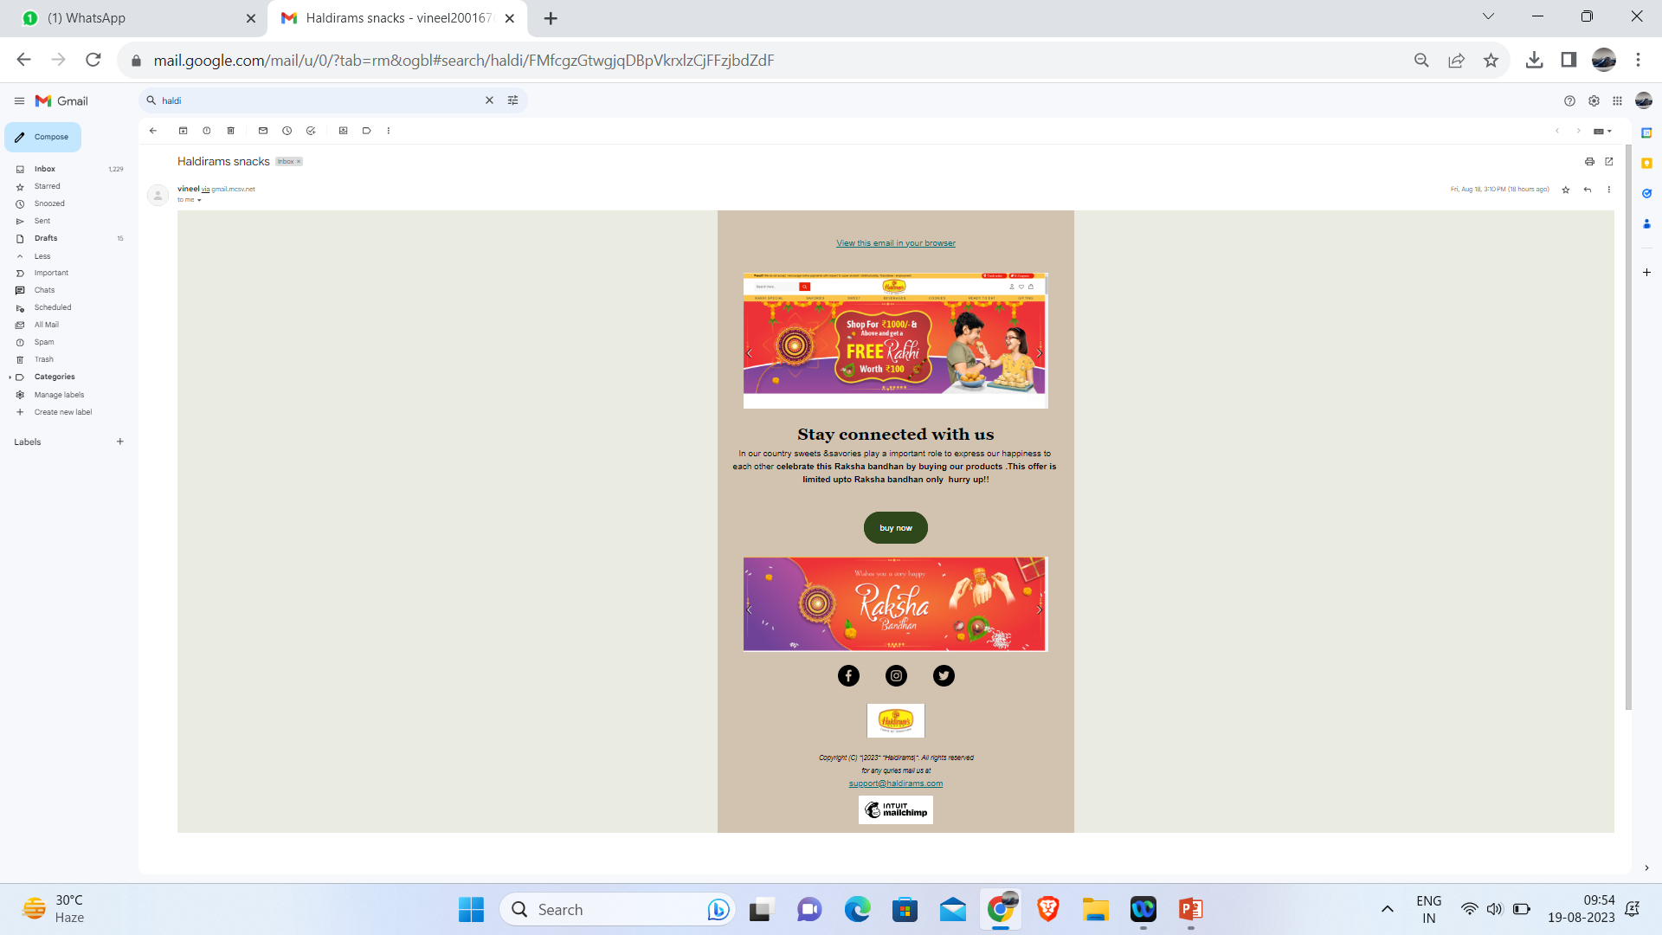
Email Ad Campaign 2 - Lead Generation
(insert emailer image)

Slide 47
Part 4: Content Creation and Curation (Post creations, Designs/Video
Editing, Ad Campaigns over Social Media and Email Ideation and Creation)
Reflect on the content creation and curation process, discussing the challenges faced and lessons learned.
Based on the analysis of the engagement metrics, the strategies and areas for improvement of the performance of social media posts and stories using the insight tool, here are 11 tried-and-tested ways to increase your platform engagement in 2023:
Engaging Through Stories Stickers
Creating Relatable Memes
Creating Shareable Graphics
Sharing Information in Carousel Posts
Include Call-to-actions
Let Your Personality Shine on Stories
Hosting a Giveaway
Collab on Instagram Reels
Using the Add Yours Sticker
Post When Your Audience Is Engaged
Using Relevant Hashtags

